Slide 1
Global Asset Allocation Practice 8
Miguel Ángel González Álvarez
Emilly Noelia Villacís Recalde
Quinten Woumans
Edoardo Anfelli
Stokely Ross

Slide 2
Takeaways
The Markowitz optimal portfolio slightly outperforms the initially proposed portfolio, although neither Sharpe ratios are statistically significant.
We would reject HF’s investment proposal.
We chose low cost ETFs and gave them weights based on neutral portfolio mix and regional exposure to mimic FGAAFF, obtaining a cost of 0.36%.

Slide 3
Table of contents
01
Global Asset Allocation
02
Foreign and Domestic Investments
03
Replicating Global Funds
04
Takeaways
Norwegian Oil Fund’s 2024
Asset Allocation Strategy
HF’s Investment Proposal
Replicating FGAAFF

Slide 4

01
Global Asset Allocation
Norwegian Oil Fund 2024 Asset Allocation Strategy

Slide 5
Global Asset Allocation
IFGL
LQD
ACWI
International Real Estate ETF that provides access to real estate investments outside of the US focusing on developed markets.
Includes holdings mainly in commercial real estate offering global diversification within the property sector
Corporate Bond ETF that invests in investment-grade corporate bonds issued by stable, established firms
Targets consistent income generation with a focus on high quality, low-risk bonds
Global Equity ETF tracking the performance of both developed and emerging global equity markets.
Offers broad exposure to large-cap stock worldwide, ensuring diversified geographic representation.

Slide 6
Global Asset Allocation
IWM
Norway 10 Year Bond
Small-cap US equity ETF that tracks the Russell 2000 index providing exposure to smaller, growth-oriented firms
Known for higher growth potential but with greater volatility compared to lager-cap stocks
Sovereign bond yield that reflects the return investors require for holding Norwegian government bonds over a ten-year period.

Slide 7
Total Expense Ratios
IFGL
LQD
ACWI
IWM
0.48%
0.14%
0.32%
0.19%

Slide 8
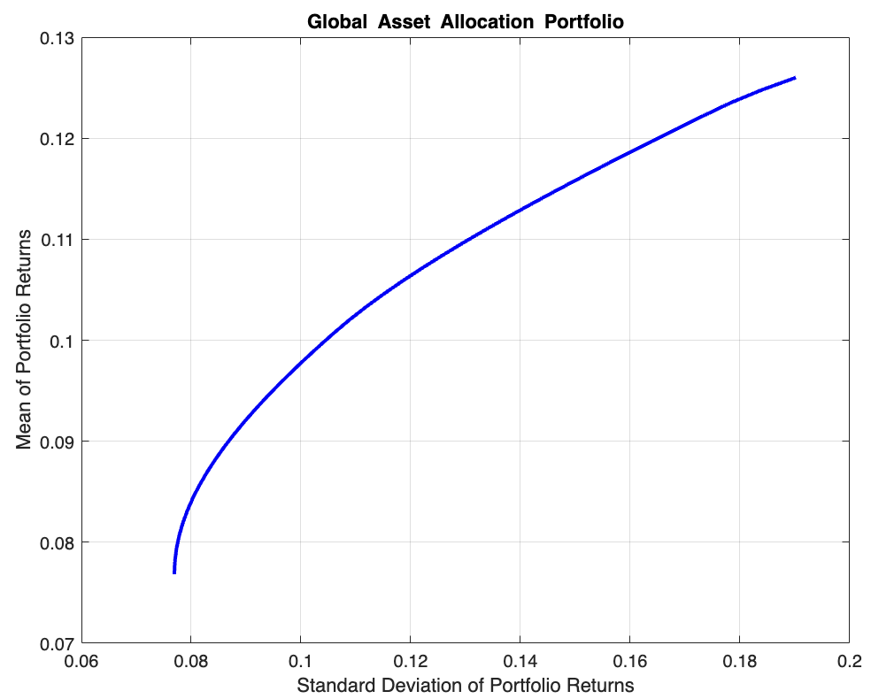
Markowitz Optimal Portfolio
CONSTRAINTS
No more than 70% of portfolio investment in equities
No more than 20% in small-cap equities

Slide 9
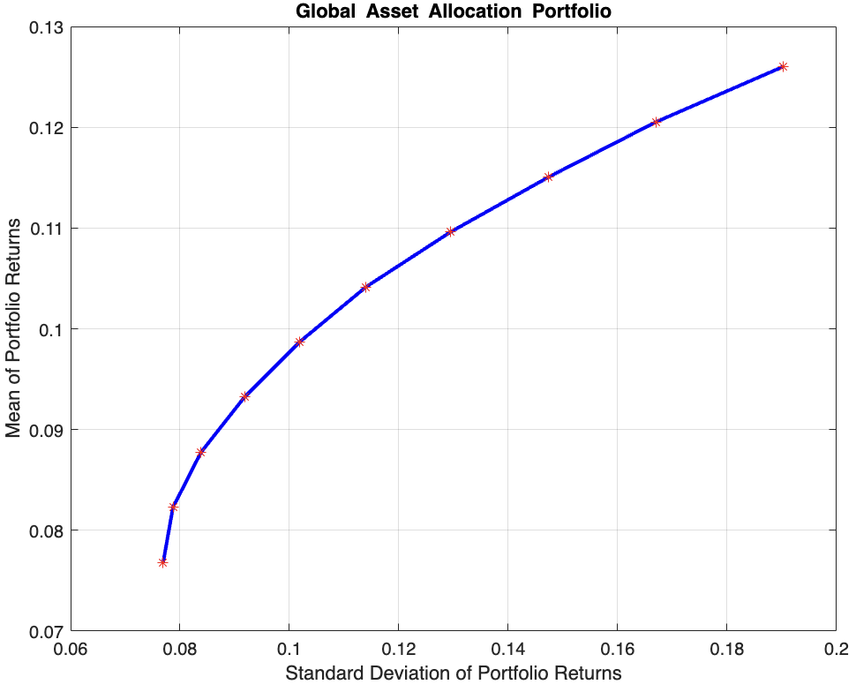
Markowitz Optimal Portfolio
OPTIMAL PORTFOLIO
Large-cap Equities: 50%
Small-cap Equities: 20%
Fixed Income: 30%
Real Estate: 0%
Portfolio that maintains required exposure limitations across asset classes

Slide 10
COMPARISON
 | INITIAL PROPOSAL PORTFOLIO | OPTIMAL PORTFOLIO
Excess Return | 0.2714% | 0.2766%
Risk | 3.6879% | 3.5381%
Sharpe Ratio | 0.0736 (0.3601) | 0.0784 (0.3306)

Slide 11
COMPARISON
Recommendation
Slightly better risk and return trade-off
Better at maximizing returns while controlling risk
Choose Optimal Portfolio.
KEY CONSIDERATIONS
Risk-Adjusted Return: If small gains in return per unit of risk are valuable, the optimal portfolio may be beneficial.
Transaction Costs: Low costs make switching more feasible; high costs may not justify the change.
Strategic Factors: Liquidity needs or specific asset preferences may favor keeping the initial portfolio.
No strong evidence of greater expected excess returns by either
Similar Sharpe Ratios, both lack of statistical evidence

Slide 12
02
Foreign and Domestic Investments
HF’s Investment Proposal

Slide 13
TopSwiss Contract Proposal
Characteristics
Key Data
Price: $857/u, including special rebate
Quantity: 100,000 u
Pricing formula: $1,000 * TS, where TS = 3-year avg. correlation between USD/Swiss Franc exchange rate and Swiss stock returns
ANNUAL VOLATILITY
Of Returns of Swiss Stock Market Index (SSMI): 10%
USD/Swiss Franc Exchange Rate: 5%
SSMI for U.S. Investors: 14% average during last 5 years

Slide 14
TopSwiss Contract Proposal
Valuation Analysis
Decision
Estimated TS: 0.71
Fair value price: $710/u, including special rebates
Overpayment by $147/u
Decline the hedge fund’s offer
Overpricing outweighs potential advantages; past market performance, currency depreciation

Slide 15
03
Replicating Global Funds
Replicating FGAAFF

Slide 16
Fidelity Global Asset Allocation Fund
General strategy
Performance
Costs
The Fund invests primarily in a mix of equity, fixed income and money market securities from around the world.
The Fund's neutral mix is 65% equity securities, 30% fixed income securities and 5% money market instruments, which may vary if the portfolio managers believe this will produce the best overall return.
Annualised return on 5 years: 5.85%
Annualised standard deviation: 9.30
Expense Ratio is 2.26%

Slide 17
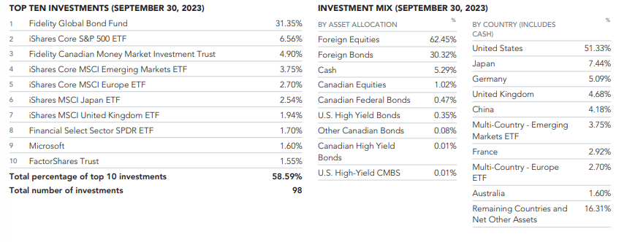
Fidelity Global Asset Allocation Fund
Fund’s investments on 30/09/2023

Slide 18
30% Fixed income allocation
General strategy
SPDR Bloomberg Global Aggregate Bond UCITS ETF (SPFB)
Costs
Fidelity Global Bond Fund
The Fund invests primarily in foreign fixed income securities. It uses the Bloomberg Global Aggregate Bond Index as a guide to structuring the Fund and selecting investments.
Provides exposure to a globally diversified portfolio of investment-grade bonds across developed and emerging markets
Ensure that the fixed income portion of the portfolio captures global bond performance
Keep management fees low
Expense ratio is 0.1%

Slide 19
5% Money market allocation
General strategy
iShares Premium Money Market ETF (CMR)
Costs
Fidelity Canadian Money Market Fund
The Fund invests primarily in Canadian dollar-denominated money market instruments of Canadian and foreign issuers. The Fund may invest up to 30% of its net assets in foreign securities.
Provide the portfolio with a cash-like asset that can act as a buffer against market fluctuations
Low-risk cash allocation strategy and maintains liquidity
Investment grade debt securities, including treasury bills and promissory notes issued or guaranteed by Canadian governments or their agencies, bankers’ acceptances and commercial paper (excluding asset-backed commercial paper) issued by Canadian chartered banks, loan companies, trust companies and corporations.
Expense ratio is 0.05%

Slide 20
65% Equity allocation
General strategy
5 ETF’s with weights based on region exposure
Globally diversified, with significant exposure to U.S. equities and developed markets outside the U.S., as well as a smaller allocation to emerging markets
iShares Core S&P 500 UCITS ETF (CSPX) - 32.5% - provides substantial U.S. exposure,
iShares Core MSCI Europe UCITS ETF (IMEA)- 13% - provides exposure to developed European markets
iShares MSCI Japan UCITS ETF (CSJP) - 6.5% - provides exposure to Japanese equities
iShares MSCI UK UCITS ETF (CSUK) - 6.5% - provides exposure to UK equities
iShares Core MSCI Emerging Markets IMI UCITS ETF (EIMI) - 6.5% - provides exposure to emerging markets

Slide 21
65% Equity allocation
Costs
iShares Core S&P 500 UCITS ETF (CSPX) - Expense ratio is 0.18%
iShares Core MSCI Europe UCITS ETF (IMEA) - Expense ratio is 0.12%
iShares MSCI Japan UCITS ETF (CSJP) - 6.5% - Expense ratio is 0.12%
iShares MSCI UK UCITS ETF (CSUK) - 6.5% - Expense ratio is 0.33%
iShares Core MSCI Emerging Markets IMI UCITS ETF (EIMI) - Expense ratio is 0.05%

Slide 22
Performance Comparison
Fidelity Global Asset Allocation Fund (FGAAFF)
Portfolio mimicking FGAAFF
Annualised return on 5 years: 5.85%
Annualised standard deviation: 9.30
Annualised Sharpe Ratio: 0.63 (7.27*10^-6)
Costs: Expense Ratio is 2.26%
Annualised return on 5 years: 4.5146%
Annualised standard deviation: 12.3240%
Annualized Sharpe Ratio: 0.3663 (0.0042)
Costs: 0.36%

Slide 23
04
Takeaways

Slide 24
Takeaways
The Markowitz optimal portfolio slightly outperforms the initially proposed portfolio, although neither Sharpe ratios are statistically significant.
We would reject HF’s investment proposal.
We chose low cost ETFs and gave them weights based on neutral portfolio mix and regional exposure to mimic FGAAFF, obtaining a cost of 0.36%.

Slide 25
Thanks!
Do you have any questions?

